Slide 1
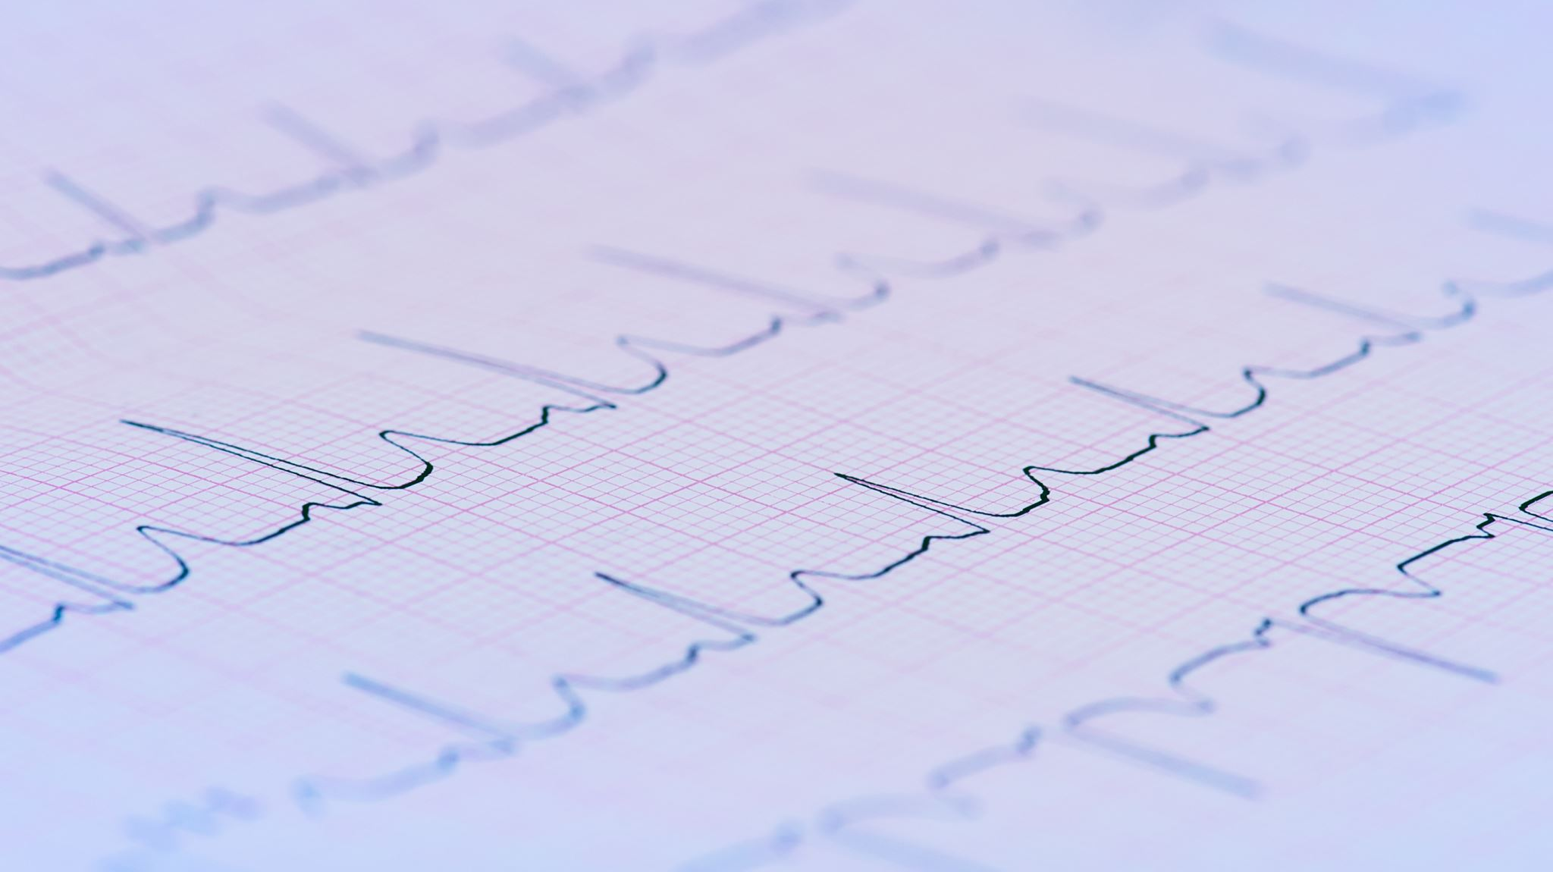
The Use of Heart Rate Variability in Cognitive and Behavioral Sciences
Lauren Kennedy-Metz, PhD
Medical Robotics and Computer-Assisted Surgery Lab (PI: Zenati)
Harvard Medical School
VA Boston Healthcare System

Slide 2
Overview
Heart rate
How it’s measured and what it tells us
Heart rate variability
How it’s measured and what it tells us
Applications
Calculating HRV

Slide 3
Heart rate

Slide 4
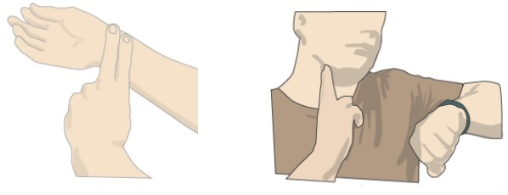
How HR is measured
Average beats per minute

Slide 5
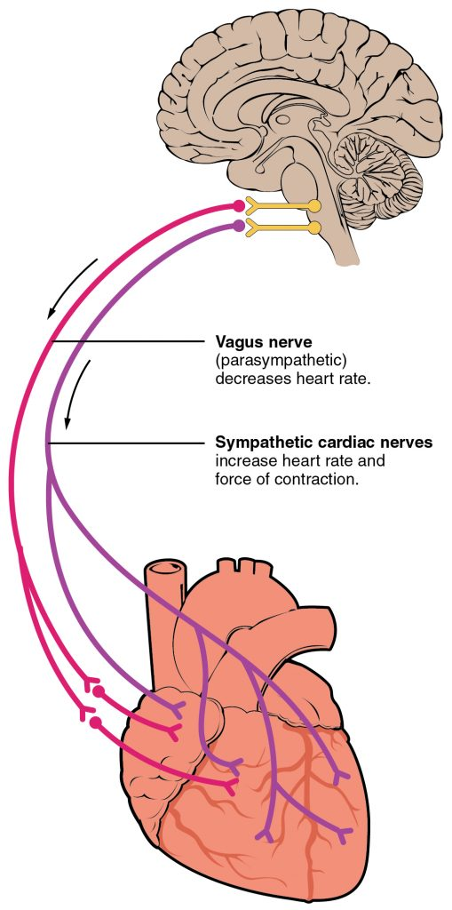
What HR tells us
Sympathetic activation
The effects of training on the cardiovascular system

Slide 6
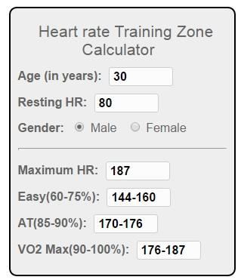
Primary use for HR
Monitoring exertion during exercise
Notes:
I ran cross country and track and field competitively in high school and in college
In high school, we would take our own pulses before, immediately after, and 5 minutes after one leg of a workout
Our coach would record these and we would use it to guide our own targets in the future
In college, we had to wear heart rate monitors (Garmins and/or chest straps) to monitor our heart rate before, immediately after, and 5 minutes after a workout, but we were also supposed to use it during workouts to determine whether we should adjust our pace
I never used a calculator like this, but just went off of how it felt
Professional athletes use this information more precisely
Something else you should take into account when determining your own target range is what your baseline level is, at rest
My resting heart rate was and still is between 50 and 55, so anything over 120 is pretty high for me
But if your resting heart rate is 80, like in this example, 120 would be below their “easy” threshold

Slide 7
Heart rate variability

Slide 8
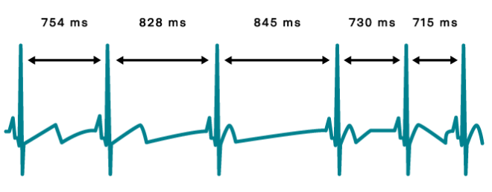
How HRV is measured
Changes in time between consecutive heart beats

Slide 9
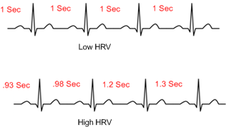
How HRV is measured

Slide 10
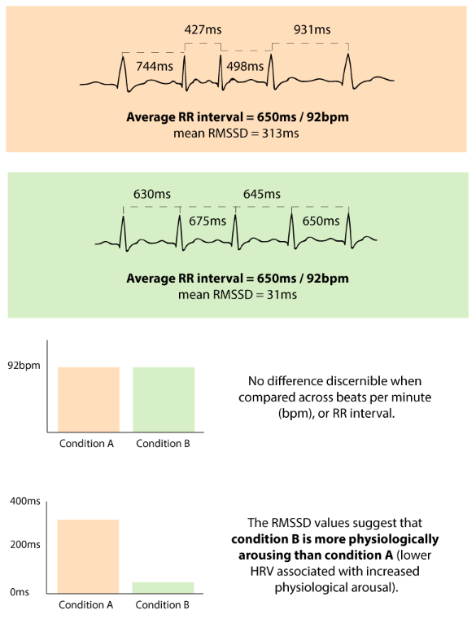
How HRV compares to HR
https://imotions.com/blog/heart-rate-variability/

Slide 11
Why does this matter?

Slide 12
What HRV tells us
Neurocardiac function
Sympathetic/parasympathetic balance

Slide 13
What HRV tells us
Higher resting HRV
Lower resting HRV
Health and well-being
Adaptability and resilience
Executive functioning
Disease states
Future health problems
Autonomic dysfunction
Shaffer & Ginsberg, An Overview of Heart Rate Variability Metrics and Norms, Frontiers in Public Health, 2017.

Slide 14
Primary use for HRV
Research
Inferring higher-order cognitive states and autonomic balance
Clinically
Predicting disease and mortality

Slide 15
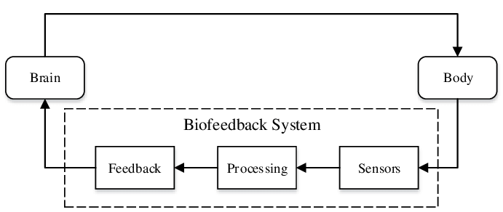
Increasing HRV
Aerobic training (Albinet et al., 2010)
Intranasal oxytocin administration (Kemp et al., 2010; Norman et al., 2011)
HRV biofeedback (Lehrer & Gervitz, 2014)
Al Osman et al., U-biofeedback: A multimedia-based reference model for ubiquitous biofeedback systems. Multimedia Tools and Applications, 2013.

Slide 16
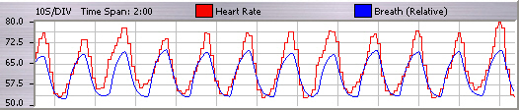
HRV biofeedback
Emphasizes psychophysiological coherence
Training can shift physiological responses and improve
Stress
Psychiatric disorders
Physical disorders
Executive function

Slide 17
Calculating HRV

Slide 18
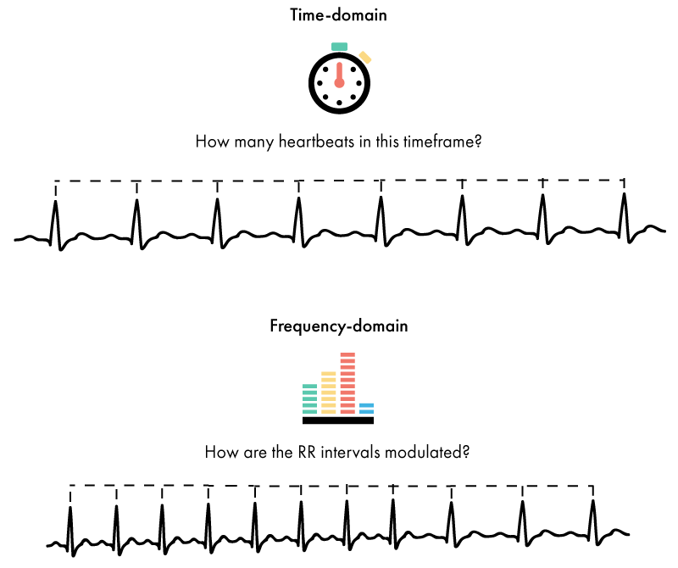
How HRV is calculated: Time-domain
Quantifying the amount of HRV observed during monitoring periods of varying length
https://imotions.com/blog/heart-rate-variability/
Notes:
Time-domain indices quantify the amount of HRV observed during monitoring periods that may range from ~2 min to 24 h.
AKA answers the question: How much variability is there?
They’re calculated based on the normal-to-normal interbeat intervals (IBIs)
AKA once the ECG trace has been cleaned and artifacts have been corrected or eliminated

Slide 19
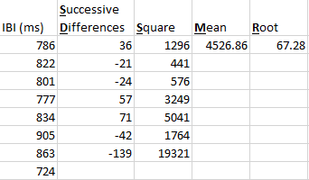
Common time-domain components
SDNN: standard deviation of all N-N intervals
Sympathetic and parasympathetic tone
RMSSD: root mean square of the successive differences
Parasympathetic tone
pNN50: percentage of consecutive N-N intervals differing by ≥50 ms
Parasympathetic tone

Slide 20
How HRV is calculated: Frequency domain
Calculating the absolute or relative amount of signal energy within component bands
https://imotions.com/blog/heart-rate-variability/
Notes:
Frequency-domain values calculate the absolute or relative amount of signal energy within component bands.
It’s based on autoregressive techniques, or fast Fourier transform (FFT)
Calculations are done by partitioning the total variance in heart rate into underlying rhythms, which occur at different frequencies
Each frequency can be associated with different intrinsic periodic rhythms that are regulated by the autonomic system
AKA answers the questions: What are the underlying rhythms? What physiologic process do they represent? How much power does each underlying rhythm have?

Slide 21
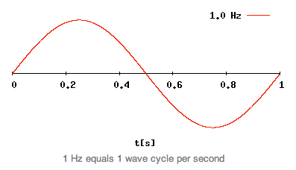
Refresher: Sine waves

Slide 22
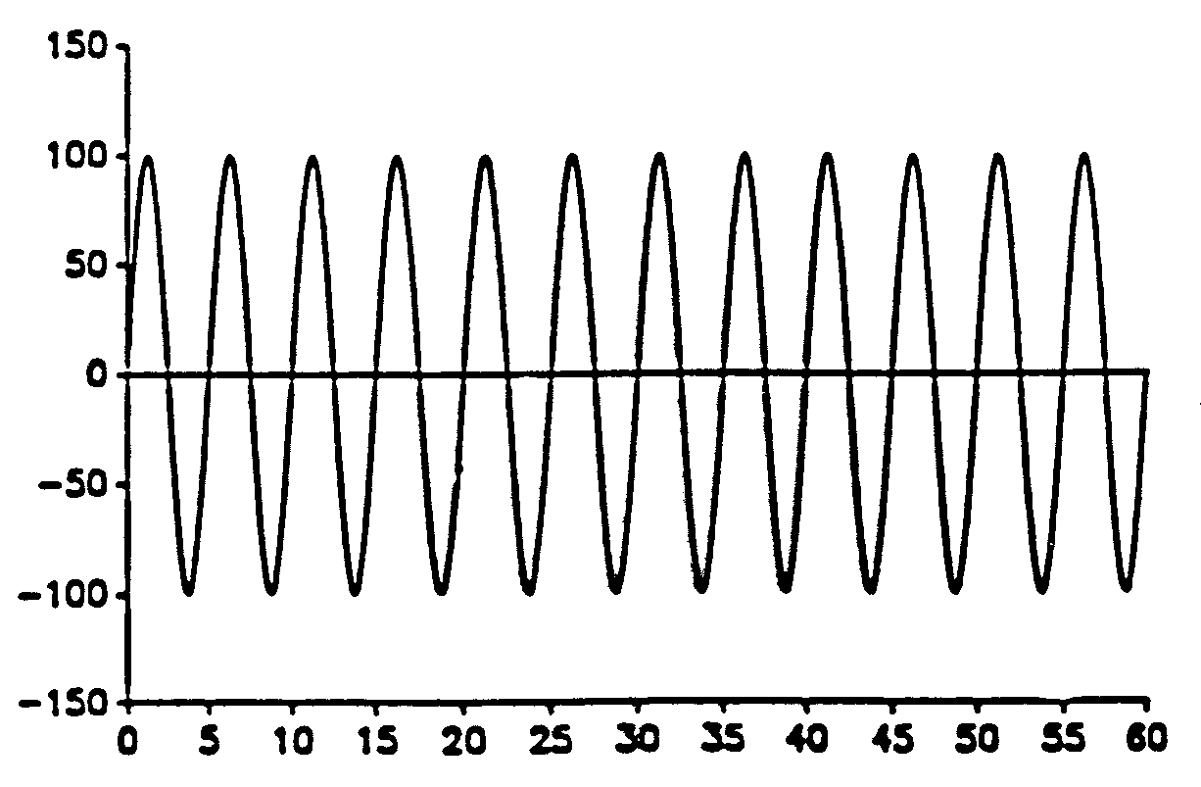
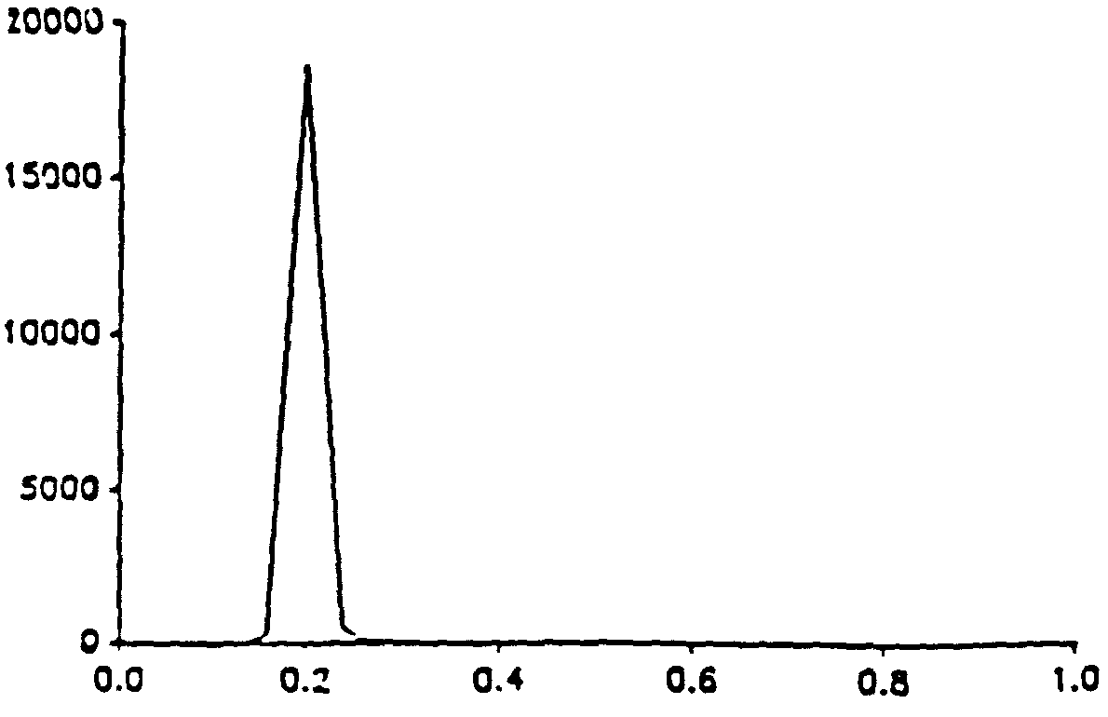
How HRV is calculated: Frequency domain
5 seconds/cycle or
12 times/min
5 seconds/cycle = 1/5 cycle/second
1/5 cycle/second = 0.2 Hz
Phyllis K. Stein, PhD

Slide 23
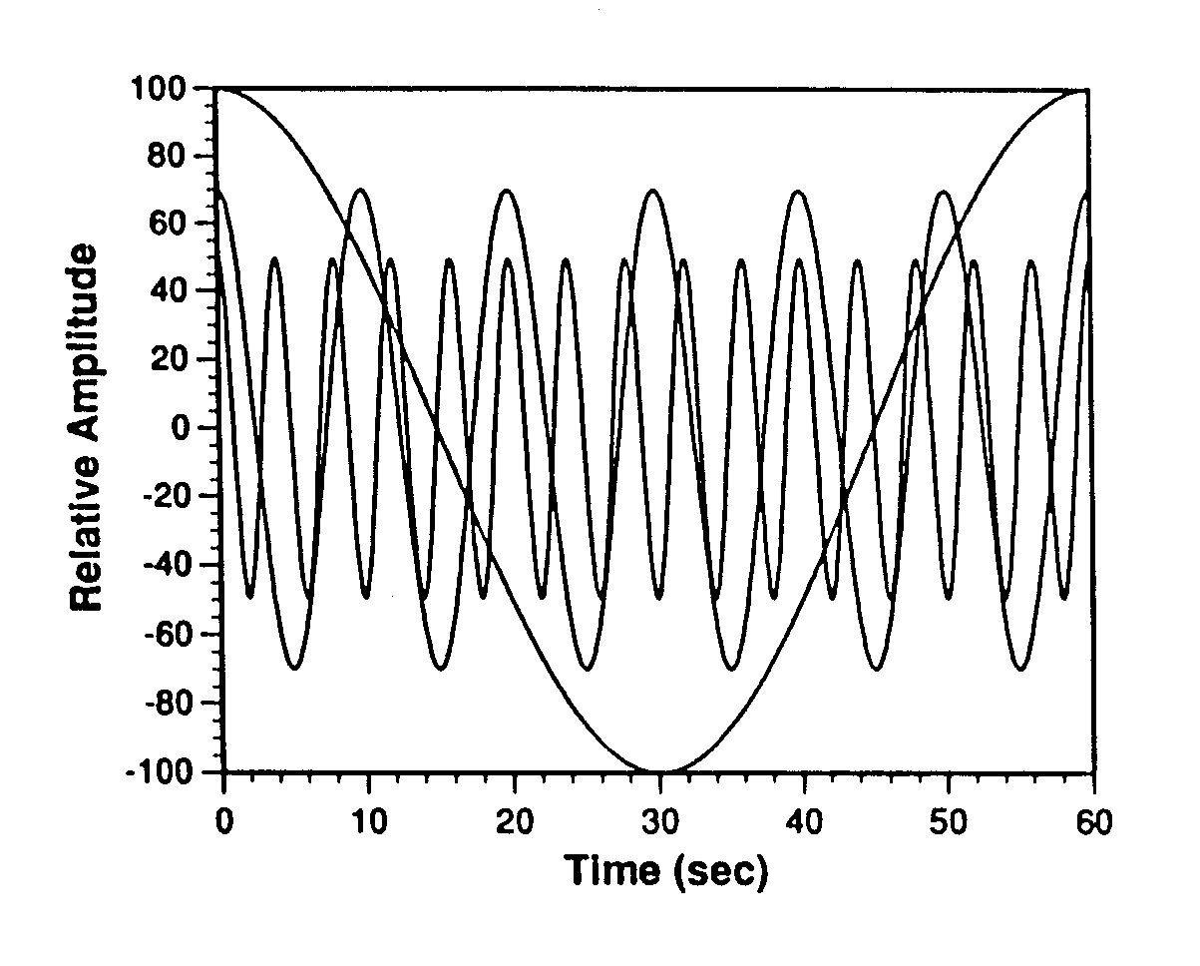
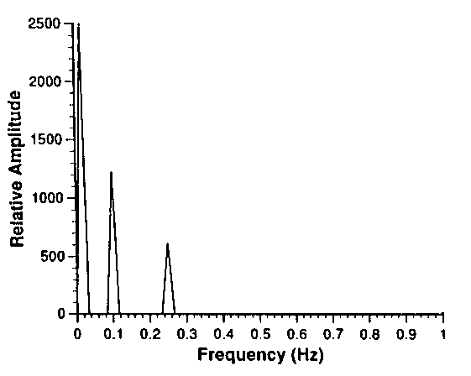
Common frequency-domain components
Three Different Rhythms
High Frequency = 0.25 Hz (15 cycles/min)
Low Frequency = 0.1 Hz (6 cycles/min)
Very Low Frequency = 0.016 Hz (1 cycle/min)
Phyllis K. Stein, PhD

Slide 24
Common frequency-domain components
Three Different Rhythms
High Frequency = 0.25 Hz (15 cycles/min)
Low Frequency = 0.1 Hz (6 cycles/min)
Very Low Frequency = 0.016 Hz (1 cycle/min)
Phyllis K. Stein, PhD

Slide 25
Common frequency-domain components
Three Different Rhythms
High Frequency = 0.25 Hz (15 cycles/min)
Low Frequency = 0.1 Hz (6 cycles/min)
Very Low Frequency = 0.016 Hz (1 cycle/min)
Phyllis K. Stein, PhD

Slide 26
Common frequency-domain components
Three Different Rhythms
High Frequency = 0.25 Hz (15 cycles/min)
Low Frequency = 0.1 Hz (6 cycles/min)
Very Low Frequency = 0.016 Hz (1 cycle/min)
Phyllis K. Stein, PhD

Slide 27
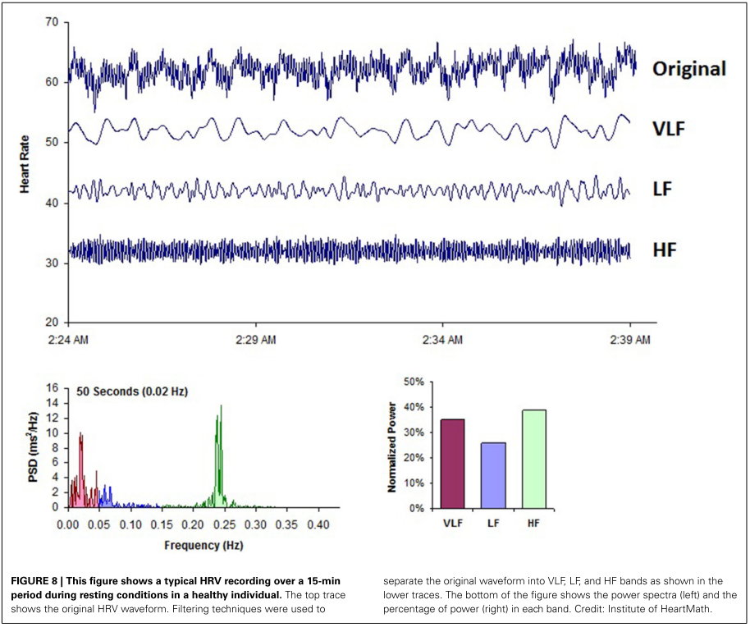
Shaffer, McCraty, & Zerr, A healthy heart is not a metronome: An integrative review of the heart’s anatomy and heart rate variability, Frontiers in Psychology, 2014

Slide 28
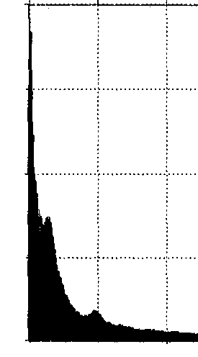
LF peak
HF peak
0
0.20 Hz
0.40 Hz
24-hour average of 2-min power spectral plots in a healthy adult
Phyllis K. Stein, PhD

Slide 29
Common frequency-domain components
Low frequency (LF) power: relative power of the low-frequency band (0.04–0.15 Hz)
Combination of parasympathetic, sympathetic, and baroreflex input
High frequency (HF) power: relative power of the high-frequency band (0.15–0.4 Hz)
Parasympathetic tone
LF/HF ratio: ratio of LF-to-HF power

Slide 30
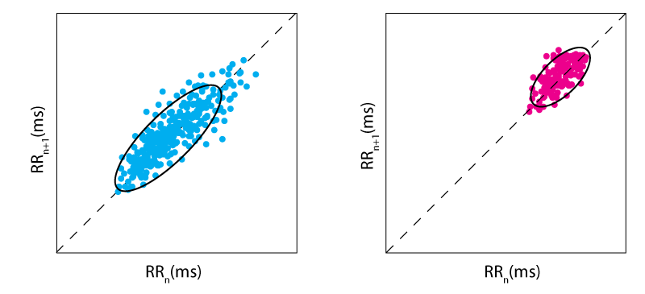
How HRV is calculated: Non-linear
Quantifying the unpredictability and complexity of a series of IBIs
https://imotions.com/blog/heart-rate-variability/

Slide 31
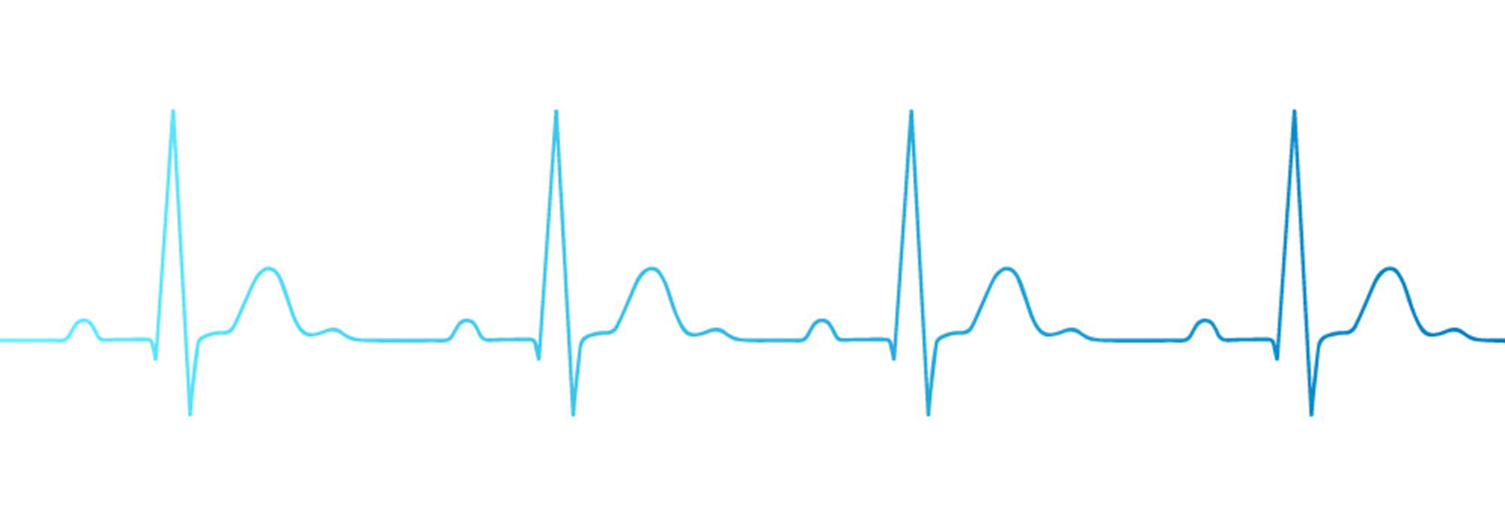
Why use HRV?
Sensitive, versatile, non-invasive
Captures validated info about underlying states
Workload
Stress
Self-regulation
Resilience
Multiple analytical approaches
Calculations
Time windows

Slide 32
Questions?
Lauren.Kennedy-Metz@va.gov

Slide 33
Resources to learn more
Task Force of the European Society of Cardiology and the North American Society of Pacing and Electrophysiology. 1996. Heart rate variability: Standards of measurement, physiological interpretation and clinical use. Eur. Heart J. 17, (1996), 354–381. DOI:https://doi.org/10.1161/01.CIR.93.5.1043
Fred Shaffer and J P Ginsberg. 2017. An overview of heart rate variability metrics and norms. Front. Public Heal. 5, September (2017), 1–17. DOI:https://doi.org/10.3389/fpubh.2017.00258
Paul Lehrer and Richard Gevirtz. 2014. Heart rate variability biofeedback: How and why does it work? Front. Psychol. 5, July (2014), 1–9. DOI:https://doi.org/10.3389/fpsyg.2014.00756

Slide 34
